Slide 1
Module-6
Reliability concepts
Reliability Definition-Quality and Reliability-Reliability Functions-Reliability Mathematics-Measures of Reliability

Slide 2
Reliability
Generally defined as the ability of a product to perform as expected over time
Formally defined as the probability that a product, piece of equipment, or system performs its intended function for a stated period of time under specified operating conditions

Slide 3
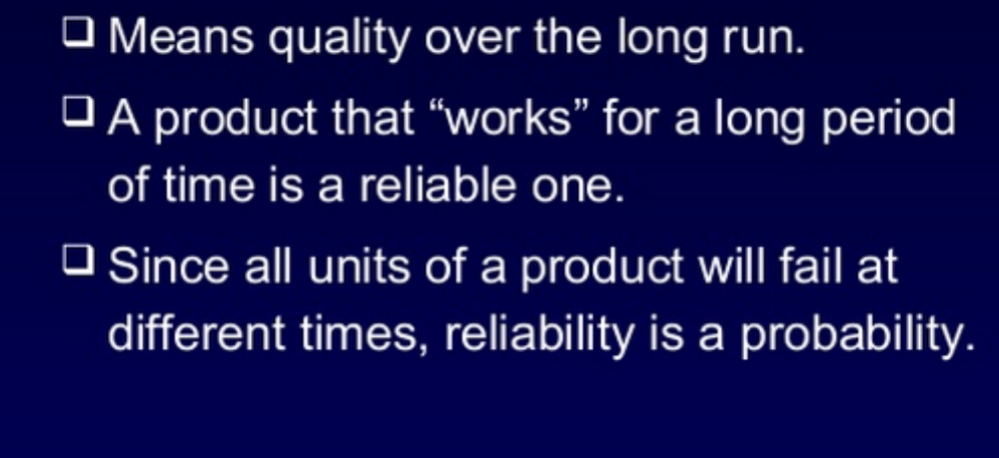

Slide 4
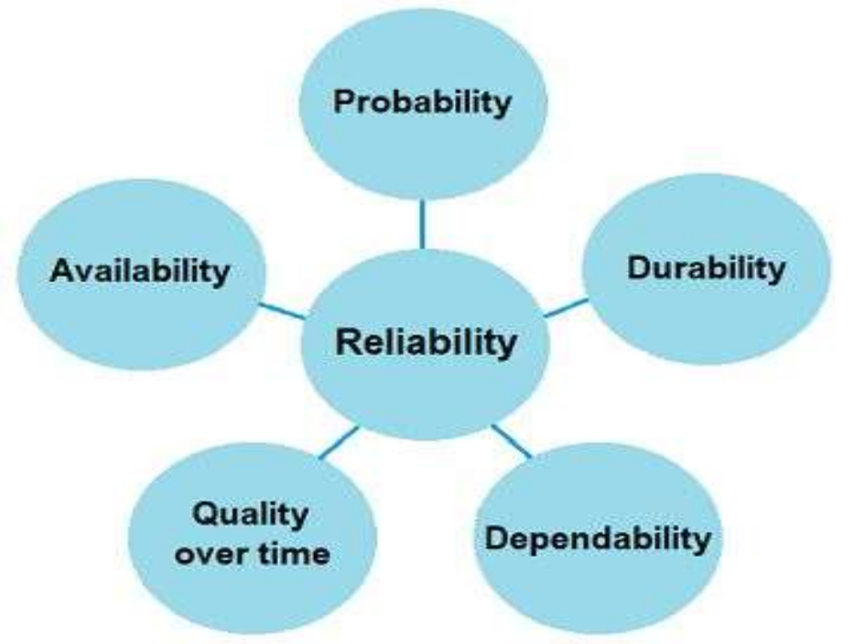
Components of Reliability

Slide 5
The most important components of this definition must be clearly understood to fully know how reliability in a product or service is established:
Probability: the likelihood of mission success
Intended function: for example, to light, cut, rotate, or heat
Satisfactory: perform according to a specification, with an acceptable degree of compliance
Specific period of time: minutes, days, months, or number of cycles
Specified conditions: for example, temperature, speed, or pressure

Slide 6
Common examples of product reliability statements or guarantees include:
"This car is under warranty for 40,000 miles or 3 years, whichever comes first."
"This power has a lifetime guarantee."
Quality = Does the object perform its intended function? If so, how well does it perform its intended function?
Reliability = To what level has said object maintained this level of quality over time?

Slide 7
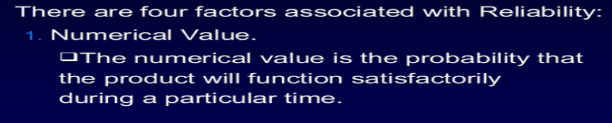
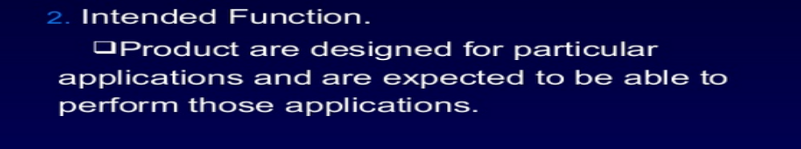
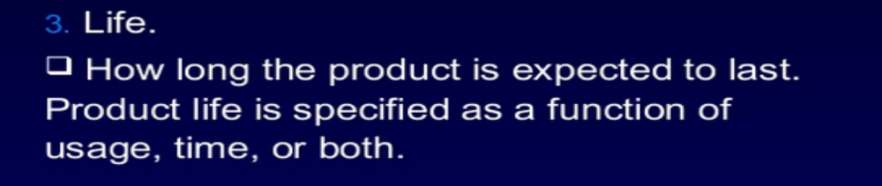

Slide 8
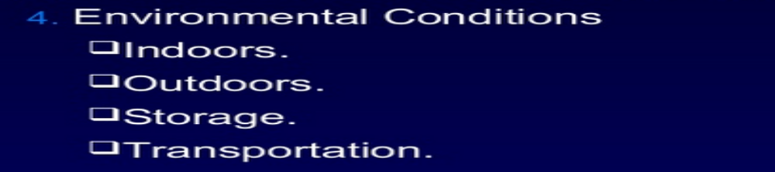

Slide 9
Reliability and its Requirement
Rapid evolution of new materials, components, and processes.
Complexity of the product being manufactured.
Need to meet customer demands such as availability, safety, warranty.
To meet desired MTBF, product costs.
Compliance with the Governmental regulations.

Slide 10
Maintainability
The probability that a system or product can be retained in, or one that has failed can be restored to, operating condition in a specified amount of time.

Slide 11
Types of Failures
Functional failure – failure that occurs at the start of product life due to manufacturing or material detects
Reliability failure – failure after some period of use

Slide 12
Types of Reliability
Inherent reliability – predicted by product design
Achieved reliability – observed during use

Slide 13
Reliability Measurement
Failure rate (λ) – number of failures per unit time
Alternative measures
  Mean time to failure
  Mean time between failures

Slide 14
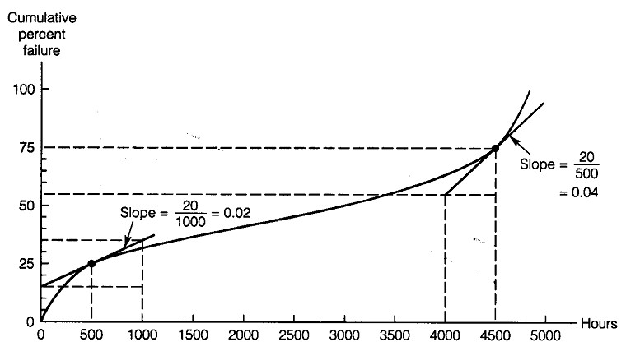
Cumulative Failure Rate Curve

Slide 15
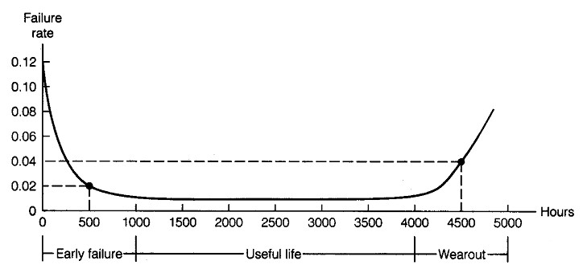
Failure Rate Curve
“Infant mortality period”

Slide 16
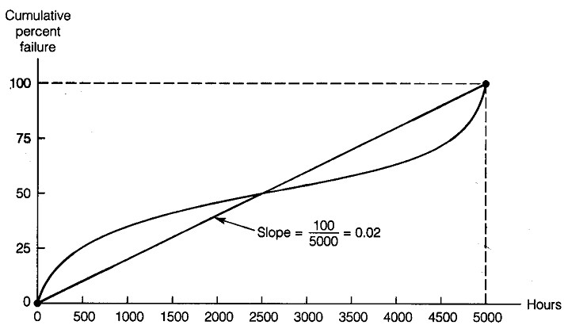
Average Failure Rate

Slide 17
Reliability Function
Probability density function of failures f(t) = λe^{-λt} for t > 0
Probability of failure from (0, T)
F(t) = 1 – e^{-λT}
Reliability function
R(T) = 1 – F(T) = e^{-λT}

Slide 18
Mean Time to Failure
In reliability terminology, the mean of the random variable T in the absence ofrepair and replacement is known as the mean time to failure (MTTF).
MTTF is a measure which simply gives a number (in units of time in which life of theproduct/component is measured) that tells us on an average how long the product/component performs its intended function successfully

Slide 19
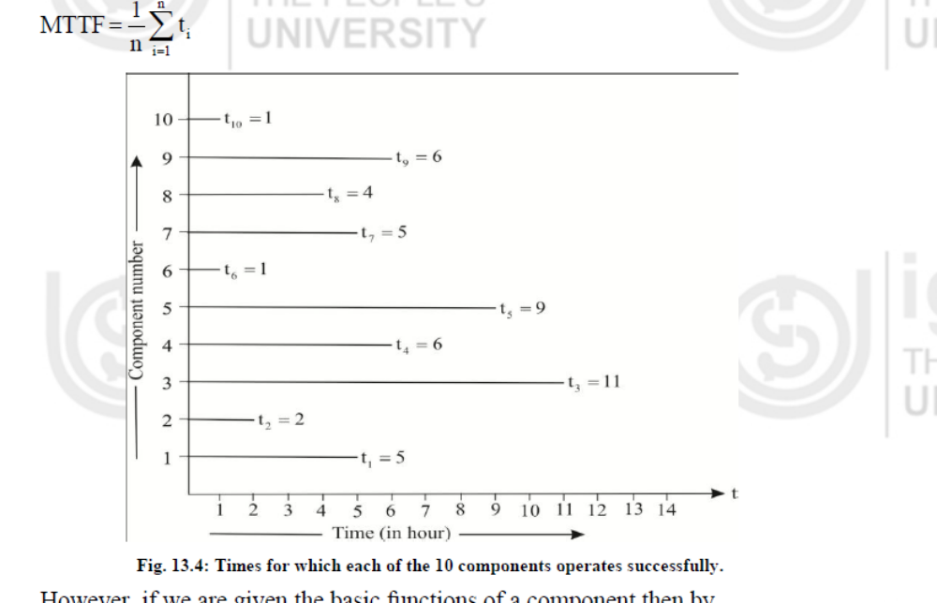

Slide 20
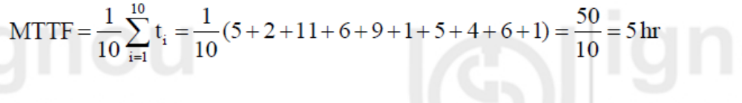

Slide 21
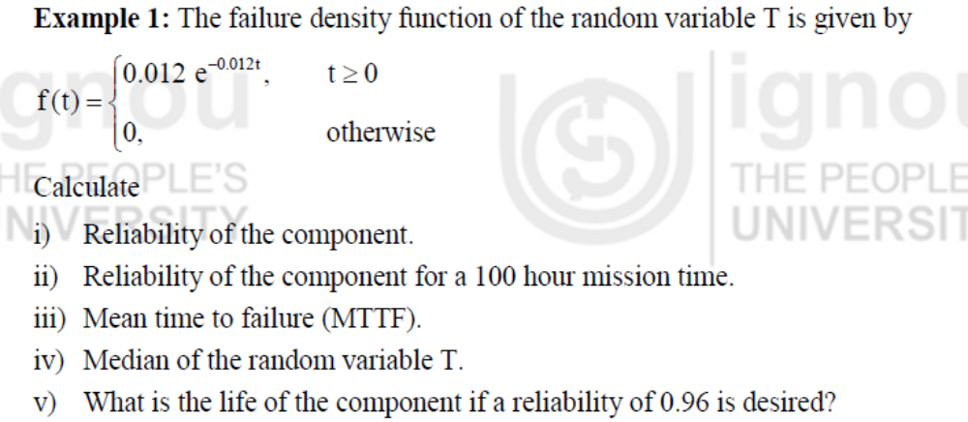

Slide 22
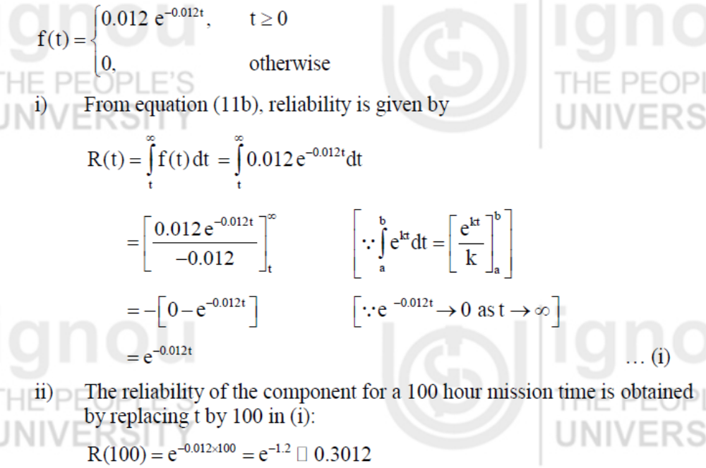

Slide 23
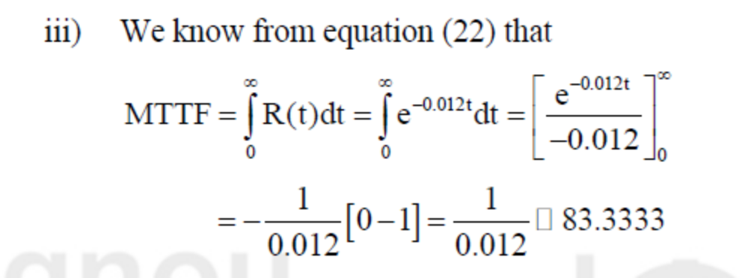

Slide 24
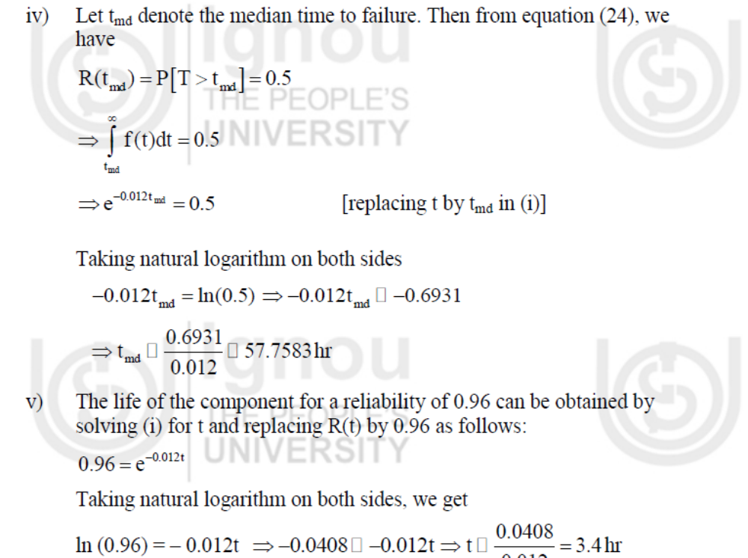

Slide 25
Bathtub Curve
Until now we assumed that failure rate of equipment is time (age) independent. In real-life, variation as per the bathtub shape has been observed
Failure Rate λ(t)
Infant Mortality
(Early Life Failures)
Steady State
Wear out
Operating Time

Slide 26
Early-life Period
Also called infant mortality phase or reliability growth phase
Caused by undetected hardware/software defects that are being fixed resulting in reliability growth
Can cause significant prediction errors if steady-state failure rates are used
Availability models can be constructed and solved to include this effect
Weibull Model can be used

Slide 27
Steady-state Period
Failure rate much lower than in early-life period
Either constant (age independent) or slowly varying failure rate
Failures caused by environmental shocks
Arrival process of environmental shocks can be assumed to be a Poisson process
Hence time between two shocks has the exponential distribution

Slide 28
Wear out Period
Failure rate increases rapidly with age
Properly qualified electronic hardware do not exhibit wear out failure during its intended service life (Motorola)
Applicable for mechanical and other systems
Weibull Failure Model can be used

Slide 29
Bathtub curve
DFR phase: Initial design, constant bug fixes
CFR phase: Normal operational phase
IFR phase: Aging behavior
h(t)
(burn-in-period)
(wear-out-phase)
CFR
(useful life)
DFR
IFR
t
Decreasing failure rate
Increasing fail. rate

Slide 30
Availability (Repairable systems)
“What is the probability that the engine of a formula 1 car will work during the whole race?”
  This is a reliability question
“How often do I hear the dial tone when I pick up the phone?”
  This is an availability question
Availability is the probability of finding the system in the operating state at any arbitrary time in the future
Unlike in the context of reliability we now consider systems that can be repaired

Slide 31
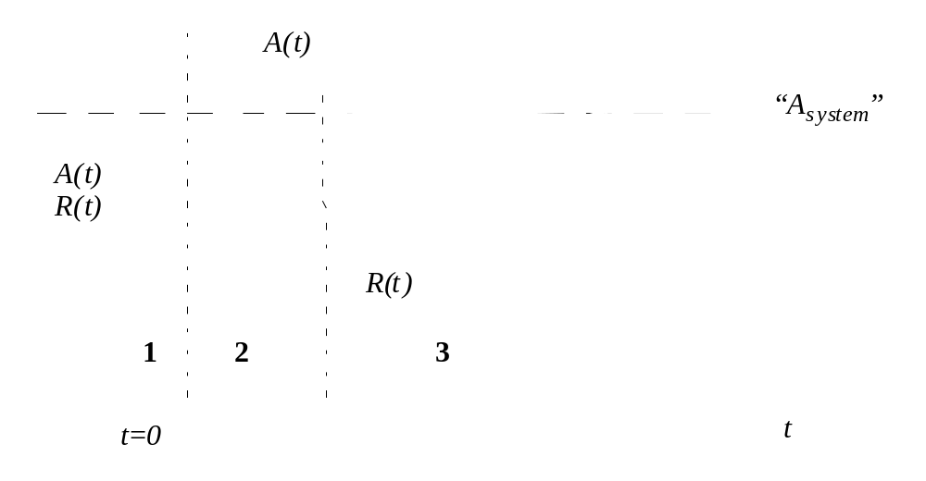
Availability
Comparison of Availability and Reliability Functions:
Region 1: R(t) and A(t) are the same
Region 2: Repair actions begin to hold up A
Region 3: A reaches a steady state

Slide 32
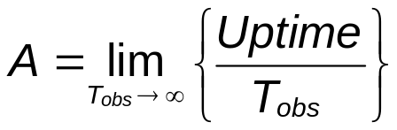
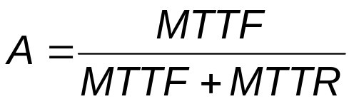
Availability
Time
Between Failures
Time
to Repair
Time
to Failure
Time
to Repair
MTTF: Mean-Time To Failure
MTBF: Mean-Time Between Failures
MTTR: Mean-Time To Repair
t
Failure
Repair
Failure
Repair

Slide 33
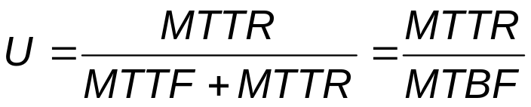

Availability
Unavailability:
In availability analysis we usually work with unavailability quantities because of some simplifications that can be done on the unavailability of elements in series and in parallel
FIT: Unit corresponding to 1 failure in 10⁹ hours
1 FIT = 1 failure in 114,155 years
1 failure / year = 114,155 FITS (high!)
Typical value for telecom equipment: 1500 FITS
( MTTF = 76 years )

Slide 34
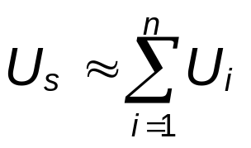
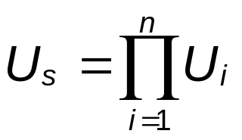
Availability
Series elements unavailability reduction:
Numerical examp.
1
2
3
. . .
n
U_{i} = 10⁻³, n = 3
Approximation based on the fact that U_{i} << 1
→ U_{s} = 3 . 10 ⁻³
Parallel elements unavailability reduction:
1
2
→ U_{s} = 10 ⁻⁹
. . .
n

Slide 35
Availability Analysis
The reliability engineer can use different techniques to evaluate the availability of a system:
  1) Quick estimate of a lower bound for the unavailability
  2) Series and parallel unavailability reductions
  3) Cut set method
  4) Tie paths method
  5) Conditional decomposition
The general methodology is explained next…

Slide 36
Availability Analysis
General Methodology:
  1) Get unavailability values of all components and sub-systems.
  2) Draw parallel and series availability relationships
  3) Reduce the system availability model by repeated applications of the parallel/series availability simplifications.
  4) If not completely reduced, do quick unavailability lower bound estimation, use the tie paths method, the cut sets method or the conditional decomposition

Slide 37
Availability Analysis
Lower bound on unavailability
  The contributions of parallel elements to the unavailability is not taken into account
B
D
F
A
C
G
H
E
Lower bound of U_{s}: U_{A}+U_{H}
  In some cases this quick evaluation of a lower bound on U can be enough to conclude that the system does not meet the availability requirements

Slide 38
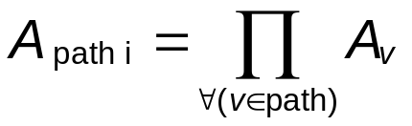
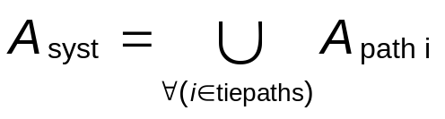
Availability Analysis
Tie paths method:
  We enumerate all the paths from I to O
3
4
O
I
5
I
O
2
1
2
5
3
1
B
4
6+7
8 || 9
A
A
B
  The availability of each paths is calculated:
  The availability of the system is:

Slide 39
Series Systems
1
2
n
R_{S} = R₁ R₂ ... R_{n}

Slide 40
Parallel Systems
1
2
n
R_{S} = 1 - (1 - R₁) (1 - R₂)... (1 - R_{n})

Slide 41
Series-Parallel Systems
C
R_{A}
R_{B}
R_{D}
R_{C}
A
B
D
C
R_{C}
Convert to equivalent series system
R_{A}
R_{B}
R_{D}
A
B
C’
D
R_{C’} = 1 – (1-R_{C})(1-R_{C})

Slide 42
Reliability Engineering
Standardization
Redundancy
Physics of failure
Reliability testing
Burn-in
Failure mode and effects analysis
Fault tree analysis

Slide 43
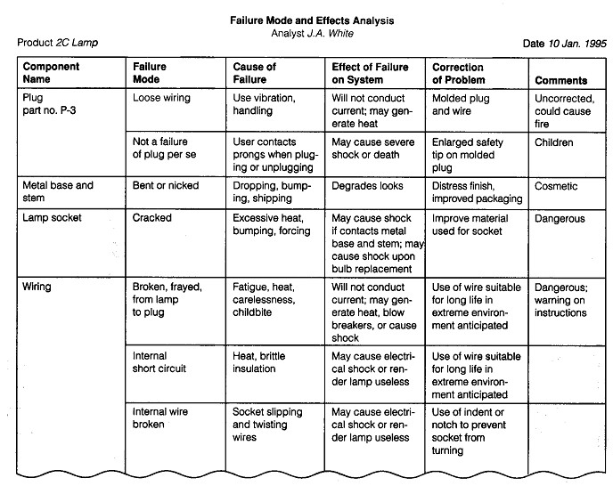

Slide 44
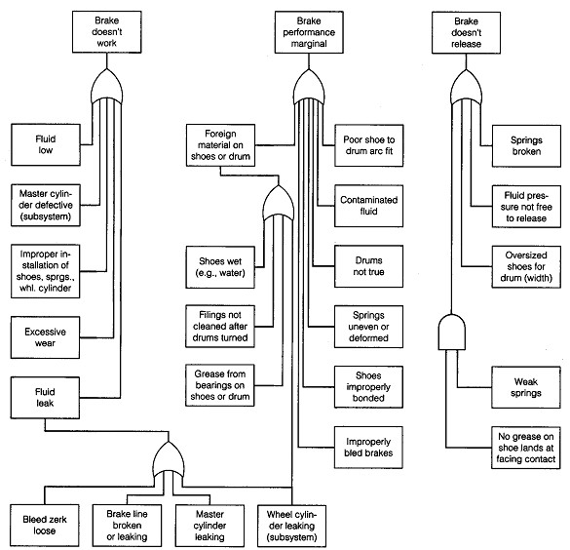

Slide 45
Reliability Management
Define customer performance requirements
Determine important economic factors and relationship with reliability requirements
Define the environment and conditions of product use
Select components, designs, and vendors that meet reliability and cost criteria
Determine reliability requirements for machines and equipment
Analyze field reliability for improvement

Slide 46
Configuration Management
Establish approved baseline configurations (designs)
Maintain control over all changes in the baseline programs (change control)
Provide traceability of baselines and changes (configuration accounting)

Slide 47
Maintainability
Maintainability is the totality of design factors that allows maintenance to be accomplished easily
Preventive maintenance reduces the risk of failure
Corrective maintenance is the response to failures

Slide 48
Design Issues
Access of parts for repair
Modular construction and standardization
Diagnostic repair procedures and expert systems

Slide 49
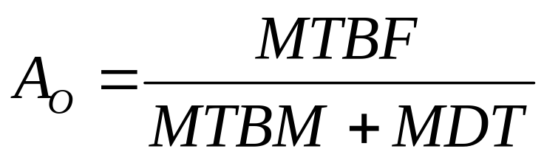
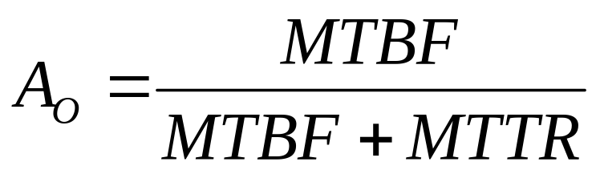
Availability
Operational availability
Inherent availability
MTBM = mean time between maintenance
MTD = mean down time
MTBF = mean time between failures
MTTR = mean time to repair

